Slide 1
CHAPTER 1
FUNCTIONS AND MODELS

Slide 2
CONTENTS
1.1 Four way to represent a function
1.2 Model and Curve Fitting
1.3 New Functions from Old Functions
1.4 Graphing Calculators and Computers
1.5 Exponential Functions
1.6 Inverse Functions and Logarithmic Functions
1.7 Parametric Curves

Slide 3
1.3 NEW FUNCTIONS FROM OLD FUNCTIONS
1.3.1 Transformations of functions
1.3.2 Combinations of functions
1.3.3 Composition of functions

Slide 4
1.3.1 Transformations of functions
Vertical and horizontal shifts (translations)
Suppose c > 0. Then by shifting the graph of y=f(x) a distance of
c units | we obtain the graph of
upward | y = f(x) + c
downward | y = f(x) – c
to the right | y = f(x – c)
to the left | y = f(x + c)

Slide 5
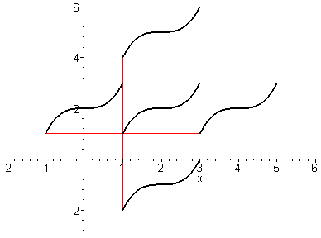
Translating the graph of f
y=f(x)+c
y=f(x+c)
y=f(x)
y=f(x – c)
y=f(x) – c

Slide 6
Vertical and horizontal stretching and reflecting
Suppose c>1. Then by transforming the graph of y=f(x) we obtain the corresponding new graph
Transformation | New graph
Stretching vertically by factor c | y=cf(x)
Compression vertically by factor c | y=(1/c)f(x)
Compression horizontally by factor c | y=f(cx)
stretching horizontally by factor c | y=f(x/c)
Reflection about x-axis | y=–f(x)
Reflection about y-axis | y=f(–x)

Slide 7
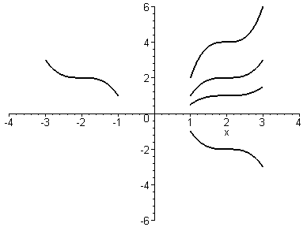
Stretching and reflecting the graph of f
y=cf(x) (c>1)
y=f (–x)
y=f(x)
y=cf(x) (c<1)
y=–f (x)

Slide 8
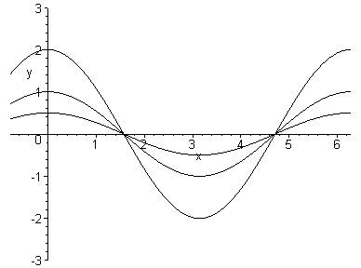
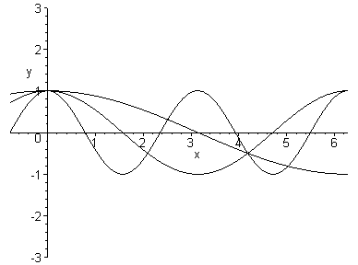
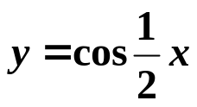
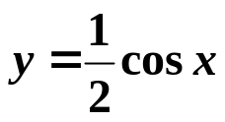
Example
y=2cosx
y=cosx
y=cos2x
y=cosx

Slide 9
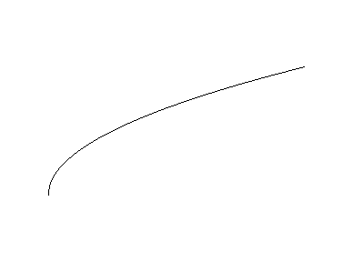



Example
Shifting 2 units downward
Shifting 2 units to the right
1
2
-2

Slide 10

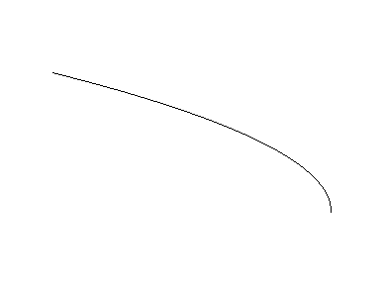


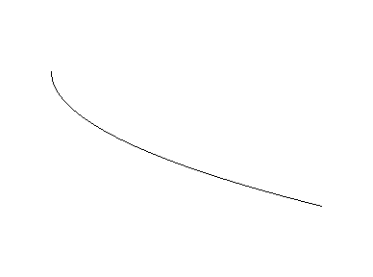

Reflecting about x-axis
Reflecting about y-axis
stretching vertically by 2

Slide 11
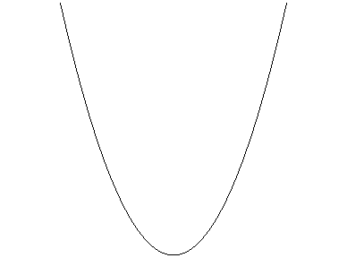
Example: sketch the graph of y=x²+6x+10
Solution: y=(x+3)²+1, therefore the graph is obtained from that of y=x² by shifting 3 units to the left, and then 1 unit upward
(-3,1)

Slide 12
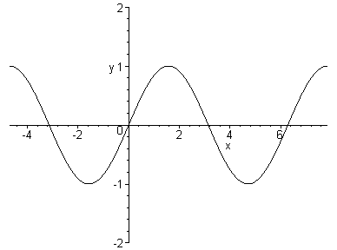
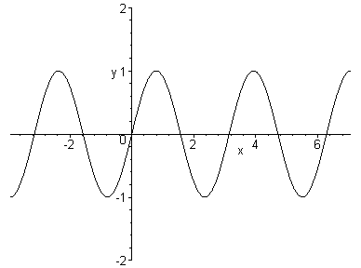
Example: sketch the graph of (a) y=sin2x (b) y=1-sinx
Solution. We obtain the graph of y=sin2x from that of y=sinx by compressing horizontally by a factor of 2
y=sinx
y=sin2x

Slide 13
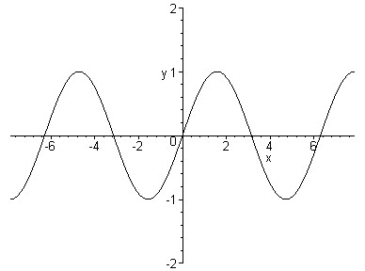
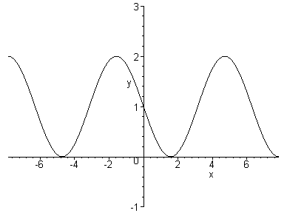
(b) We obtain the graph of y = 1 – sinx from that of y = sinx by reflecting about x-axis
(to obtain the graph of y = –sinx) and then shifting 1 unit upward
y=sinx
y=1–sinx

Slide 14
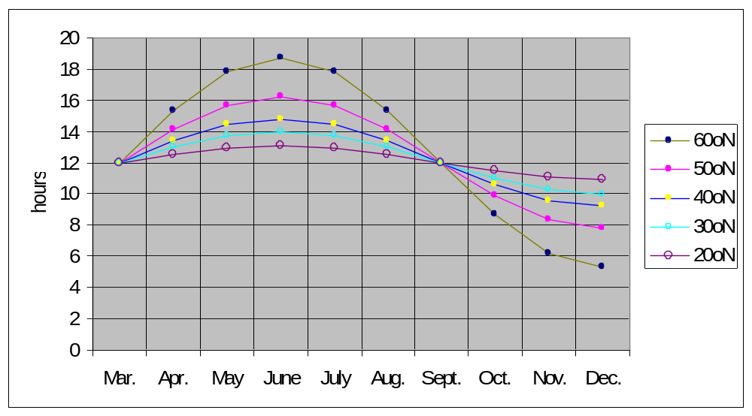
Example: the graphs of hours of daylight as functions of time at several latitudes
The shapes of the curves suggest us to use the sine function as our model.

Slide 15
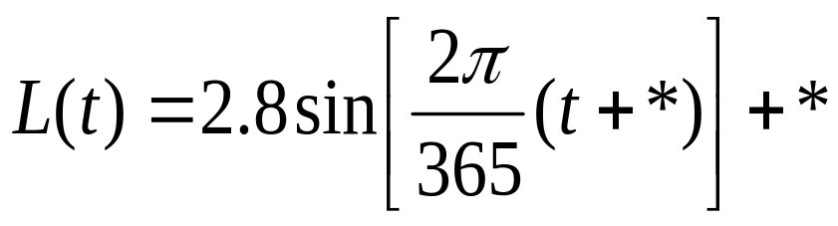
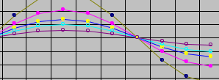
Philadelphia is near the 40ºN lattitude corresponding to the blue curve with yellow marks: the maximum is 14.8 hours and minimum is 9.2 hours.
Therefore the amplitude is: ½(14.8-9.2)=2.8
Hence the function must be stretch vertically by a factor of 2.8.
The period is 365 days while the period of sint is 2π hence we need to stretch horizontally by a factor of 2π/365.

Slide 16
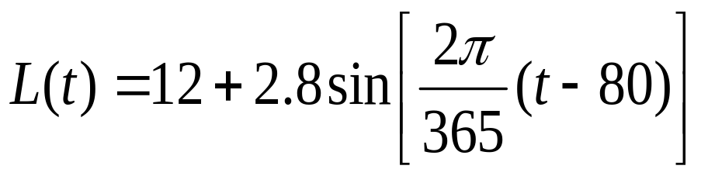
Since the number of days elapsed from Jan 1st to March 21st is 80
Hence we must shift to the right 80 unit
Finally the average value is 12 while the average value of sin t is 0 so we must shift uprard by 12 unit
Therefore our model should be

Slide 17
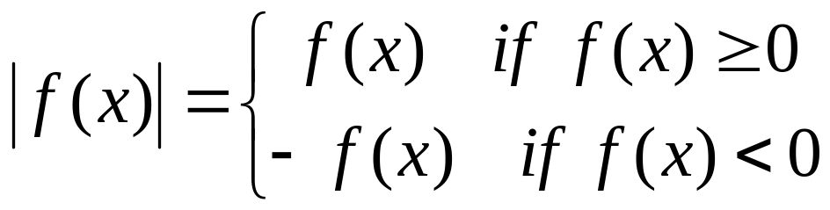
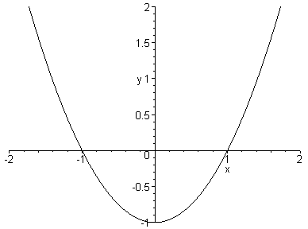
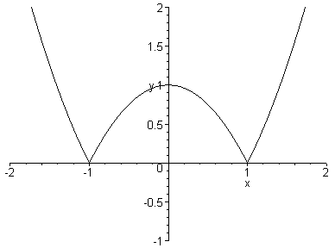
Remark:
Therefore the graph of ⏐f(x)⏐consists of the part of the graph of f(x) where f(x) ≥ 0 and that of –f(x) where f(x) < 0 as shown by the example of y = ⏐x² –1⏐

Slide 18
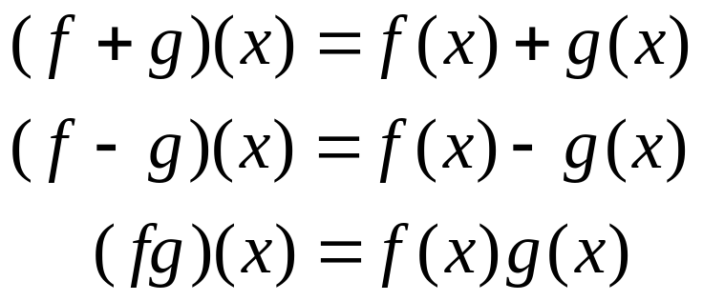
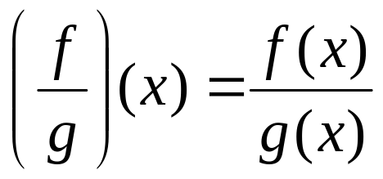
1.3.2. Combinations of functions
Algebra of functions: let f and g be functions with domains A and B. Then the functions f + g, f – g , fg and f/g are defined as follows:
domain = A∩B
domain = A∩B
domain = A∩B
domain = {x∈A∩B /g(x)≠0}

Slide 19

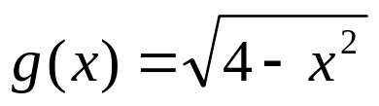
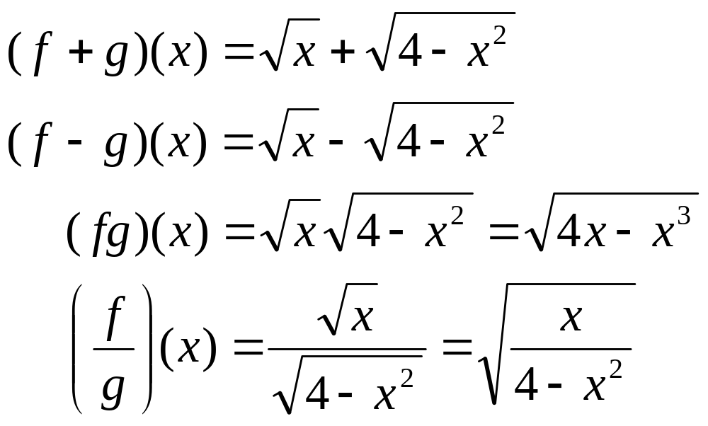
Example: let and find the functions f+g, f-g, fg and f /g
Solution: domain of f is [0,∞), domain of g consists of all x such that 4 – x² ≥ 0, i.e. x² ≤ 4 or –2 ≤ x ≤ 2.
domain(f) ∩ domain(g) = [0,∞) ∩ [-2,2]=[0,2]
0 ≤ x ≤ 2
0 ≤ x ≤ 2
0 ≤ x ≤ 2
0 ≤ x < 2

Slide 20
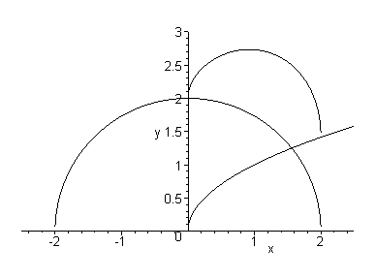
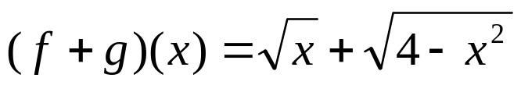
g(a)
f(a)+g(a)
f(a)
a

Slide 21
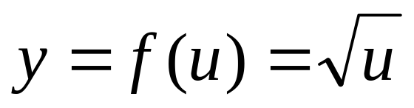
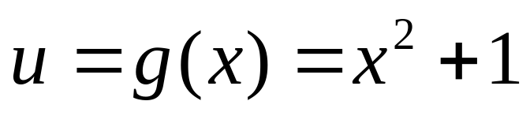
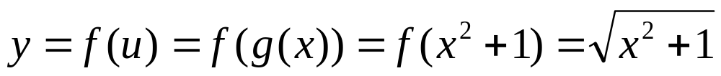
1.3.3. Composition of functions
Let and
Substituting the expression of u=x²+1 in f(u) we obtain:

Slide 22
Definition: the composition of two functions f and g is the function fog defined by
fog(x) = f(g(x))
The domain of fog consists of all x in the domain of g such that f(g(x)) is defined
x (input)
g
g(x)
f
f(g(x)) (output)

Slide 23
Arrow diagram for f o g
f og
•x
g
f
• f(g(x))
• g(x)

Slide 24
Example: let f(x) = x² and g(x) = x – 3 find the compositions fog and gof
Solution:
(fog)(x) = f(g(x)) = f(x – 3) = (x –3)²
(gof)(x) = g(f(x)) = g(x²) = x² – 3
This shows that in general: fog ≠ gof

Slide 25

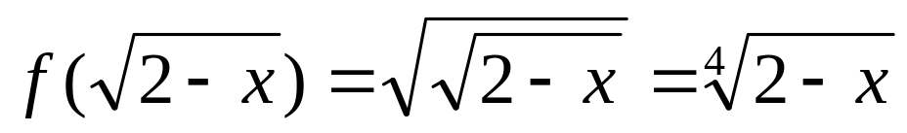
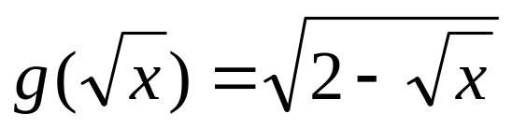
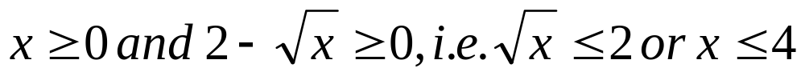
Example: let and find the functions fog, gof, and their domains
Solution:
(a) (fog)(x) = f(g(x)) =
domain(fog) ={x / 2 – x ≥ 0 } = (–∞, 2]
(b) (gof)(x) = g(f(x)) =
We have
Therefore domain (gof) = [0,4]

Slide 26
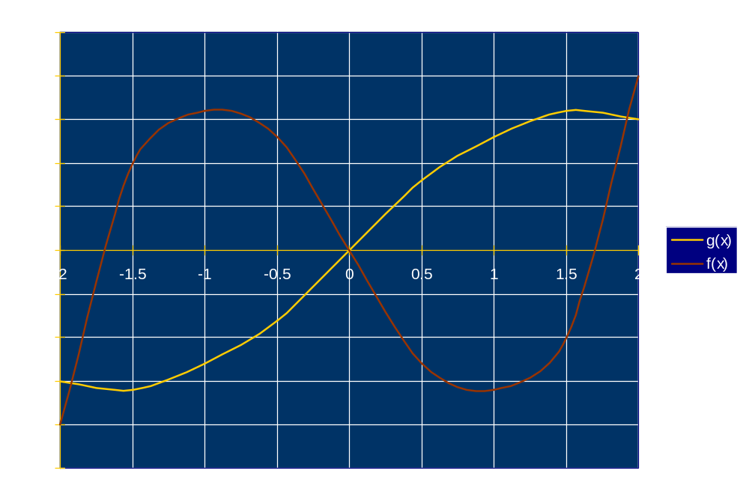
Example: the graphs of f and g are as follows, and h=fog. Estimate h(0.5) and sketch the graph of h
Solution: g(0.5) ≈ 0.8 and f(0.8) ≈ -1.7. So (h)(0.5) ≈ f(g(0.5)) ≈ f(0.8) ≈ -1.7

Slide 27
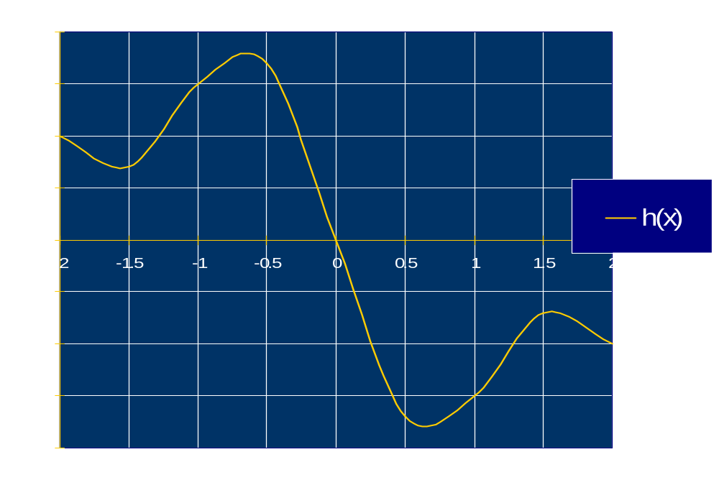
Similarly we can compute other values of h as shown in the following table. Using this we can sketch the graph of h
x | -2 | -1.5 | -1 | -0.5 | 0 | 0.5 | 1 | 1.5 | 2
g(x) | -1.5 | -1.6 | -1.3 | -0.8 | 0 | 0.8 | 1.3 | 1.6 | 1.5
h(x) | 1 | 0.7 | 1.5 | 1.7 | 0 | -1.7 | -1.5 | -0.7 | -1

Slide 28
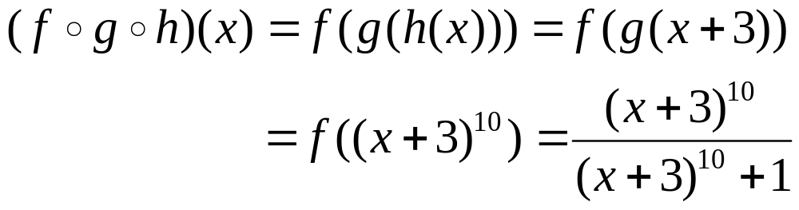
We can also define the composition of three functions or more:
(fogoh)(x)=fo(goh)(x)=f((goh)(x))=f(g(h(x)))
We have: fogoh=fo(goh)=(fog)oh
Example: f(x) = x / (x+1), g(x) = x¹⁰, h(x) = x + 3. Find fogoh
Solution:

Slide 29
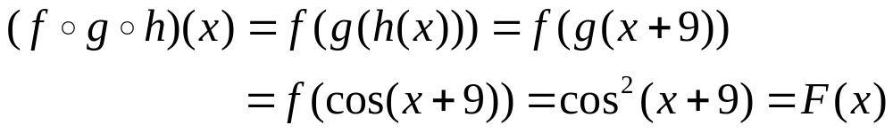
Example: Given F(x) = cos²(x+9). Find f, g, h such that F=fogoh
Solution: the expression of F suggests that we should first add 9 to x, then take the cosine function, and finally square the whole result.
Therefore:
h(x) = x + 9, g(x) = cosx and f(x) = x²

